Slide 1
Cloud Computing
Unit II
Data Storage and Cloud Computing

Slide 2
Data Storage in Cloud Computing
Cloud Storage allows to save data on offsite storage system managed by third-party, made accessible by a web services API.
Storage Devices :
Block Storage Devices
File Storage Devices

Slide 3
Storage Devices
Block Storage Devices:
Block storage chops data into arbitrarily sized, manageable chunks called blocks. Each block has a unique address but no metadata (like a filename or creation date) attached to it.
Offer raw storage to the clients. These raw storage are partitioned to create volumes.
The operating system treats these blocks as individual hard drives. Because blocks are stored wherever is most efficient on the disk, this method is incredibly fast and reliable.
Data is accessed directly by the hardware via the address. It’s like a parking garage where every spot has a number, but the garage doesn't care what kind of car is parked there.
Best For: Databases, enterprise applications, and virtual machine file systems where high performance and low latency are critical.

Slide 4
Storage Devices
File Storage Devices:
File storage (also called File-level storage) is the most familiar type for average users. It stores data as a single piece of information inside a folder. To find a file, you need the path (e.g., C:/Documents/Photos/Vacation.jpg).
The file Storage Devices offer storage to clients in the form of files, maintaining its own file system. This storage is in the form of Network Attached Storage.
It uses a hierarchical structure with nested folders and rich metadata (tags, owner, size, etc.). It’s like a library; if you want a book, you look for the genre, then the author, then the title.
Best For: User directories, archiving documents, and sharing files across a local network.

Slide 5
Cloud Storage Classes
Cloud storage can be broadly classified into two categories:
Unmanaged Cloud Storage :
It means the storage is preconfigured for the customer. The customer can neither format, nor install his own file system or change drive properties.
Managed Cloud Storage:
Managed cloud storage offers online storage space on-demand. The managed cloud storage system appears to the user to be a raw disk that the user can partition and format.

Slide 6
Creating Cloud Storage System
The cloud storage system stores many copies of data on many servers at the various locations.
The data is stored at various locations so that if one system fails it can change the pointer location to where the object is stored.
The cloud provider uses the virtualization software to aggregate the storage assets into cloud storage system. This system is called as StorageGRID.
StorageGRID creates a virtualization layer which fetches storage from various storage devices into a single management system.
It manages the data from CIFS and NFS file system over the Internet.

Slide 7
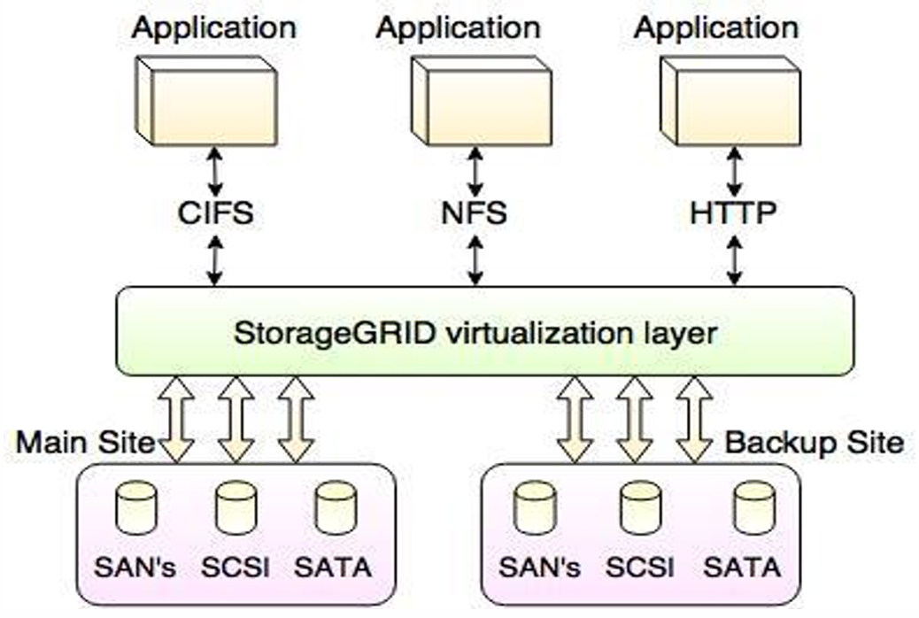
Creating Cloud Storage System

Slide 8
Virtual Storage Containers (VSC)
A logical abstraction layer that separates data from physical hardware.
A software-defined space that stores data regardless of the underlying disks.
Core Functions:
Isolation: Secure boundaries between different users.
Elasticity: Grows or shrinks automatically based on usage.
Management: Policies are applied to the container, not the hardware.

Slide 9
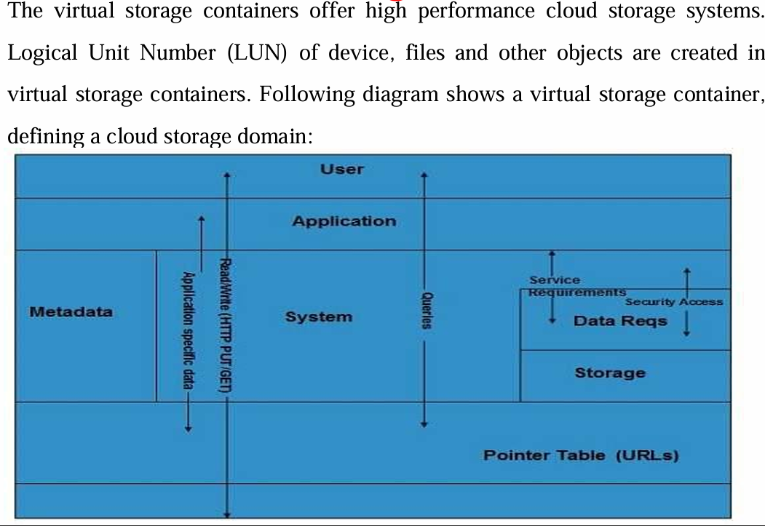
Virtual Storage Containers (VSC)

